Slide 1
Digital Portfolio
STUDENT NAME: PRIYADHARSHINI V
REGISTER NO AND NMID: 7A6E8D051F577499A2F4F265740AD65B
DEPARTMENT: BSC CS COMPUTER SCIENCE
COLLEGE: COLLEGE/ UNIVERSITY

Slide 2
PROJECT TITLE
"Digital Service Portfolio

Slide 3


AGENDA
Problem Statement
Project Overview
End Users
Tools and Technologies
Portfolio design and Layout
Features and Functionality
Results and Screenshots
Conclusion
Github Link
3/21/2024 Annual Review

Slide 4

PROBLEM STATEMENT
In the digital age, individuals and businesses require an online presence to showcase their services and expertise. Traditional methods such as printed resumes or word-of-mouth promotion are no longer sufficient. Clients often prefer to view a developer’s skills, services, and past work online before initiating contact.
The lack of a centralized, visually appealing, and accessible platform can reduce credibility and opportunities. To overcome this, a Digital Service Portfolio Website is developed to present front-end development services, technical expertise, and real-world projects in a professional and organized manner.
Notes:
In today’s digital era, having an online presence is essential for professionals, especially in the tech industry. Traditional resumes and cover letters often fail to fully capture a developer’s skills, creativity, and project experience. This creates a gap between what candidates can offer and what recruiters or clients can evaluate.
To bridge this gap, there is a growing need for an interactive and visually appealing platform where individuals can showcase their technical skills, achievements, and projects in a more personalized way. A personal portfolio website serves this purpose effectively by highlighting a developer’s capabilities through practical examples and user-friendly design.
This project addresses the problem by developing a fully responsive personal portfolio website using front-end web technologies such as HTML, CSS, and JavaScript, enabling developers to present themselves professionally and enhance their career opportunities.

Slide 5

PROJECT OVERVIEW
This project focuses on designing and developing a Digital Service Portfolio Website using front-end technologies like HTML, CSS, JavaScript, and Bootstrap. The website is aimed at displaying the developer’s services, such as web design, UI development, responsive site creation, and website optimization.

Slide 6

WHO ARE THE END USERS?
Clients looking for web development or design services
Startups and businesses needing online presence
Recruiters and hiring managers evaluating web development skills
Freelance platforms where developers need to show their portfolio
Peers or mentors reviewing work and progress

Slide 7

TOOLS AND TECHNIQUES
HTML5 – for semantic and structured content
CSS3 – for styling and visual design
JavaScript – for interactivity and dynamic features
Bootstrap – for responsive and mobile-first design
Font Awesome / Google Fonts – for icons and typography

Slide 8
POTFOLIO DESIGN AND LAYOUT
Header: Contains logo and navigation links
Hero Section: Brief introduction and call to action
About Section: Personal profile and background
Services Section: Detailed list of services provided
8

Slide 9
FEATURES AND FUNCTIONALITY
Mobile-responsive design (works on all devices)
Interactive navigation with smooth scrolling
Clickable project cards with hover effects
Contact form with basic HTML validation
Integrated social media links and GitHub profile
SEO-friendly HTML structure
Use of reusable CSS classes and JavaScript functions

Slide 10
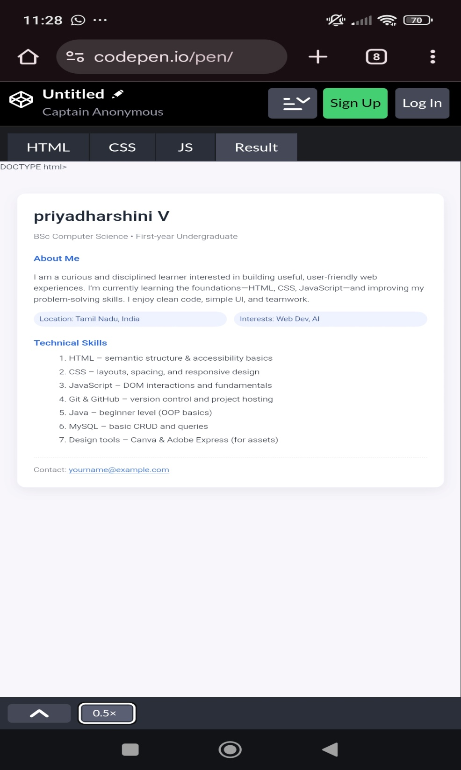

RESULTS AND SCREENSHOTS
3/21/2024 Annual Review
10

Slide 11
CONCLUSION
The Digital Service Portfolio project successfully demonstrates front-end web development skills through a well-structured, interactive, and responsive website. It helps promote services and technical strengths to potential clients, recruiters, and collaborators. The project reflects a strong understanding of UI design, responsive layouts, and user-focused development.
11

